Slide 1
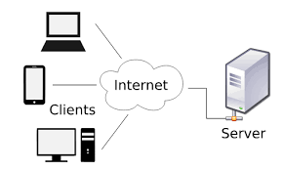
Client server communication
In client-server computing, a centralized communications model, the server is the central node that communicates with other client nodes. A major advantage that the client-server relationship has over the peer-to-peer relationship is the ability to manage data and applications in one, centralized server.

Slide 2
Securing client server communication
Now, you can implement security in 2 places-
Server side
Client side
When you implement by client side you need to implement in multiple client, but if you want to implement in server, you would be doing in 1 place only.

Slide 3
Obtaining an SSL Certificate
Purchase from a Certificate Authority (CA) like DigiCert, Comodo, Let's Encrypt, etc.
Generate a Certificate Signing Request (CSR) on your server.
Submit the CSR to the CA and complete their verification process.
Install the issued SSL certificate on your web server.

Slide 4
Certificate authority
A Certificate Authority (CA) is an entity responsible for issuing digital certificates, which are used to verify the identity of websites, organizations, and individuals on the internet. CAs play a crucial role in establishing trust and security in digital communications.

Slide 5
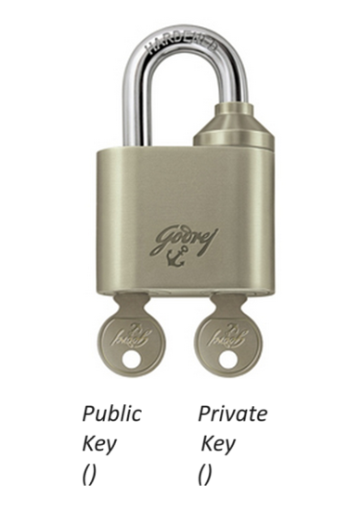
SSL Certificate
For beginner level understand SSL certificate like below lock example-

Slide 6
Public Key
Description: The public key is a part of a pair of keys used in asymmetric encryption. It is made available to anyone and is used to encrypt data.
Usage: Anyone who wants to send secure data to a recipient will use the recipient's public key to encrypt the data.
Distribution: Public keys are often distributed through digital certificates issued by Certificate Authorities (CAs).

Slide 7
Private Key
Description: The private key is the other part of the key pair and is kept secret by the owner. It is used to decrypt data that was encrypted with the corresponding public key.
Usage: Only the owner of the private key can decrypt the data that has been encrypted with the corresponding public key.
Security: The security of the private key is paramount. If it is compromised, the encrypted data can be decrypted by unauthorized parties.

Slide 8
How SSL Works
When a browser connects to a secure site, it retrieves the site's SSL certificate and checks its validity.
If the certificate is trusted, the browser and server establish an encrypted connection using a process known as an SSL handshake.
This process involves the exchange of cryptographic keys and the establishment of a secure session.

Slide 9
Benefits of SSL Certificates
Security: Protects sensitive data during transmission.
Trust: Builds trust with users by displaying trust indicators like the padlock icon in the address bar.
SEO: Search engines like Google prioritize HTTPS sites over HTTP in search rankings.
Compliance: Necessary for complying with data protection regulations like GDPR, HIPAA, etc.

Slide 10
Root intermediate and personal certificate
Link: https://www.thesslstore.com/blog/root-certificates-intermediate/

Slide 11
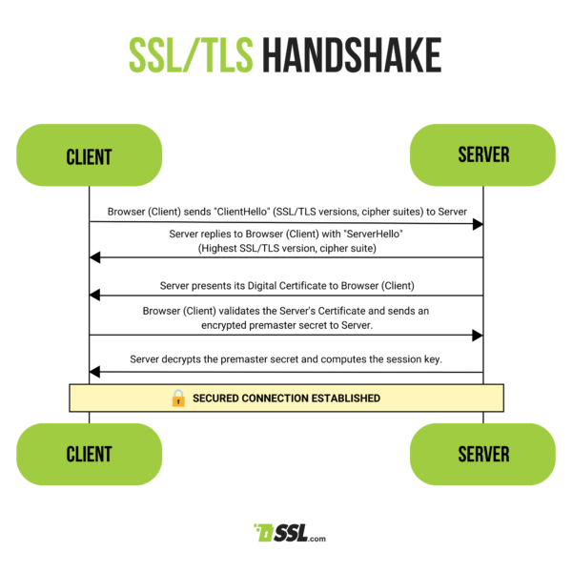
SSL handshake

Slide 12
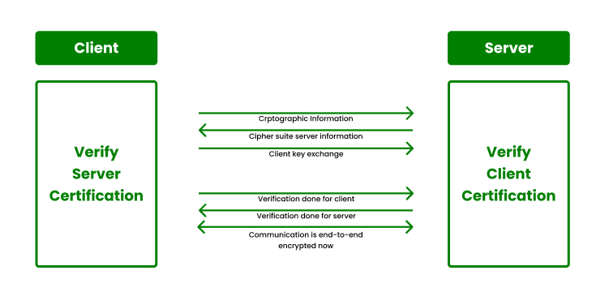
2 way SSL handshake

Slide 13
Key store and trust store
TrustStore is used to store certificates from Certified Authorities (CA) that verify the certificate presented by the server in an SSL connection. While Keystore is used to store private key and identity certificates that a specific program should present to both parties (server or client) for verification. This concludes that they are opposite of each other. In a layman’s language, we can directly conclude up that in a certification trustStore holds identification certificates that identify others while keyStore holds the identification certificates that hold us.

Slide 14
WebSphere Partner Gateway
WebSphere Partner Gateway provides centralized and consolidated business to business trading partner and transaction management to enable and manage process and data integration with trading partners. It is an integral part of the WebSphere SOA and Business Process Management (BPM)-related portfolio of business integration products by being able to participate in SOA implementations and by allowing companies to integrate their trading partners within their BPM implementations. It supports connectivity through standards-based transport protocols such as EDIINT AS1, AS2 or AS3, RosettaNet RNIF or cXML.
Link: https://mediacenter.ibm.com/channel/WebSphere+Partner+Gateway+Advanced+Edition/34074762

Slide 15
gsk7cmd
Link: https://www.ibm.com/docs/en/ibm-http-server/8.5.5?topic=environment-managing-keys-from-command-line-distributed-systems

